Slide 1
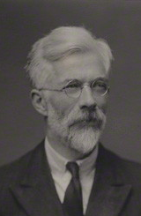
Why are Humans so Smart?
Basic idea of runaway evolution due to Ronald Fisher (whom we met as the inventor of the linear classifier)
Application to human intelligence mostly due to Geoffrey Miller
Geoffrey Miller The Mating Mind: How Sexual Choice Shaped Human Nature (2000)
This is a theory, but very plausible.
Ronald Fisher

Slide 2
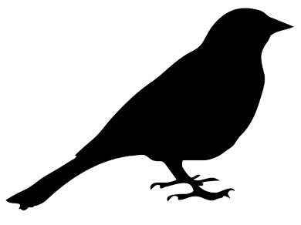
1.5 inch tail
I like guys with a two inch tail..
2 inch tail
2.5 inch tail
Sexual selection is a big driver of evolution.
The tails of a bird are control by genes, but critically, so is their behavior.
Female choice is an example of a behavior. If a female that likes 2-inch tails has daughters, it is likely that the daughters will also like 2-inch tails.
Some female choice may be rational, they may choose for strong beaks, or for good nest making ability, or….
Some (perhaps most) female choices could be arbitrary.

Slide 3
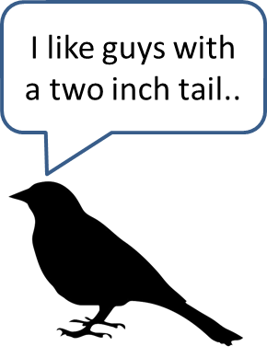
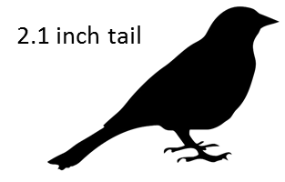
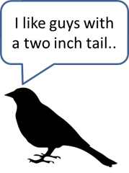
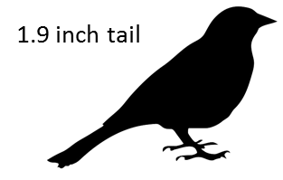
1.5 inch tail
I like guys with a two inch tail..
2 inch tail
2.5 inch tail
Under certain conditions, the genes for having a trait, and the genes for choosing the same trait, can “take hold” in a population.
If that happens, it is unlikely to ever break out of the cycle. A male that has a longer or shorter tail simply will not be able find a mate.

Slide 4
1.5 inch tail
I like guys whose tail is longer than average….
2 inch tail
2.5 inch tail
Suppose the female choice is not for a certain length tail, but for a tail that is longer than average….

Slide 5
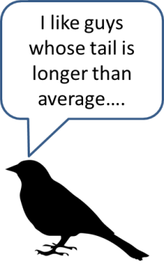
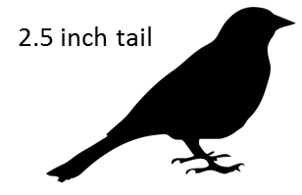


1.5 inch tail
I like guys whose tail is longer than average….
2 inch tail
2.5 inch tail
Now every generation has longer and longer tails….

Slide 6
2.9 inch tail
I like guys whose tail is longer than average….
2.8 inch tail
2.6 inch tail
Once the genes for liking longer-than-average-tails reach a critical mass, we have a positive feedback cycle….

Slide 7
5.1 inch tail
I like guys whose tail is longer than average….
6.2 inch tail
5.9 inch tail
…and the tails get longer and longer
Note that the male would be much better of without the long tail. It costs energy to grow it, it makes it very hard to fly, it makes it hard to avoid detection by predators, and hard to evade them… But any male without a long tale will not find a mate. This seems like a theoretical model, but….

Slide 8
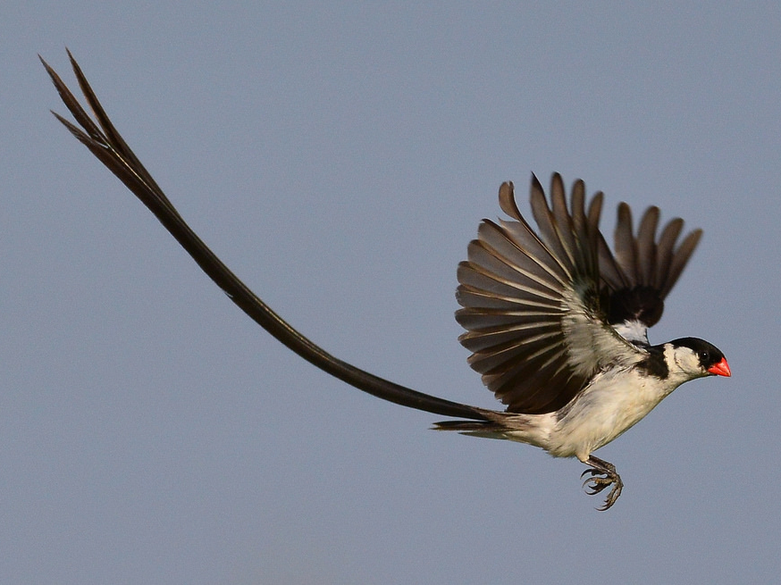
The pin-tailed whydah (Vidua macroura)

Slide 9


IQ = 90
I like guys whose are smarter than average….
IQ = 96
IQ = 50
Sometime in the last few hundred thousand years, human female choice started to select for guys that where smarter than average (how did the females know who was smart?)
So, Human intelligent is just a by-product of this arbitrary accident.

Slide 10



Before we get carried away, humans are not that smart

